Slide 1



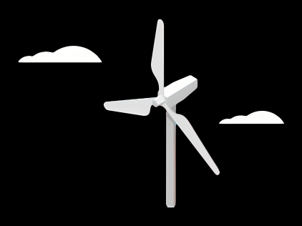
Weekly report: Team Gearbox, Brake, Coupling
Week number : 03
Date: 14/10/2025
Supervisor: Prof. Peter Quell
Group Members :Nehang Jitendra Joshi,Santo Mazumder,Md Razaul Karim Rahat
Presented by -Nehang Jitendra Joshi
14-10-2025
Nehang Jitendra Joshi
Gearbox, Brake, Coupling

Slide 2
Agenda for 4th week
Team design
Basic overview about steps for design and calculation for the Gearbox
Svendborg brake as a choice
Overview for Coupling
Coordinate with internal group--
Rotor hub,Bearing,Machine bed (Mechanical Input)
Electrical Drivetrain Team (Mechanical Output)
Chapter | Responsible person
Introduction | All team members
Project order | All team members
Gearbox | Nehang
Rotor brake | Nehang+Rahat
Coupling | Nehang+Santo
14-10-2025
Nehang Jitendra Joshi
Gearbox, Brake, Coupling

Slide 3
Steps for Gearbox Concept Design
Define gear ratio according to required input & output speed.
Define gearbox input torque according to WTGs power and gearbox input speed.
Design a gear stage including number of stages, gear split ratio and gear macro design.
Selection of bearing according to chosen gear stages.
Design of housing.
Efficiency check and design of lubrication/ cooling system.
Finalise gearbox concept design.
14-10-2025
Nehang Jitendra Joshi
Gearbox, Brake, Coupling

Slide 4
Gearbox Design & Dimensioning
Number of Transmission Stages​
Shaft Arrangement​
Gear Type​
Module & Number of teeth​
Face width​
Material Selection
14-10-2025
Nehang Jitendra Joshi
Gearbox, Brake, Coupling

Slide 5
Gearbox system
Gearbox Calculations​
Based on IEC 61400-4 standards
Stages module m selection
Good storage housing
1st stage: m = ?
2nd stage: m = ?
3rd stage: m = ?
Higher torques require higher module
Dimensioning of the gearbox
IEC-61400-4
Dimensioning of the gearbox components
ISO 281
ISO 76
ISO 6336-1
Strength analysis
Modal analysis
Simulation
14-10-2025
Gearbox, Brake, Coupling
Nehang Jitendra Joshi

Slide 6
Gearbox system
Suppliers in the market:
Winergy
(Up to 8MW, eff. Of 96.5%, 2 stages low ratio gearbox)
Eickhoff
(Up to 4.8MW, 5 planet in one stage, 2 stages low ratio gearbox)
Wikof
(Up to 10MW, Flexible pin tech, 7 planets in one stage, 2 stages low ratio gearbox)
NGC
(Up to 8MW, 2 stages high ratio gearbox)
Moventas
(Up to 5MW, 2 stages low ratio gearbox)
14-10-2025
Nehang Jitendra Joshi
Gearbox, Brake, Coupling

Slide 7
Rotor Brake
Main Objective:
Overview of brake
Installation of brake
14-10-2025
Nehang Jitendra Joshi
Gearbox, Brake, Coupling

Slide 8
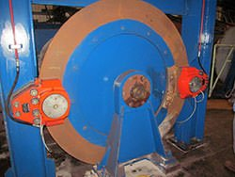
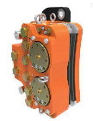
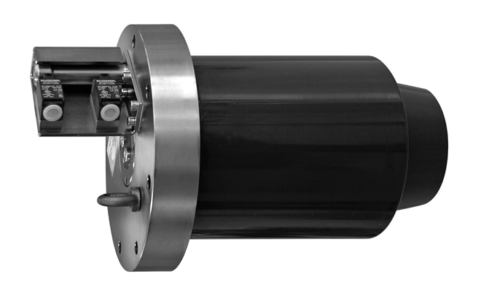

Rotor Brake
Energy supply methods:
Hydraulic
Electro-mechanic
Suppliers of locks:
Hilma Römheld
Svendborg Brakes
Suppliers of brakes
Svendborg Brakes
14-10-2025
Nehang Jitendra Joshi
Gearbox, Brake, Coupling

Slide 9
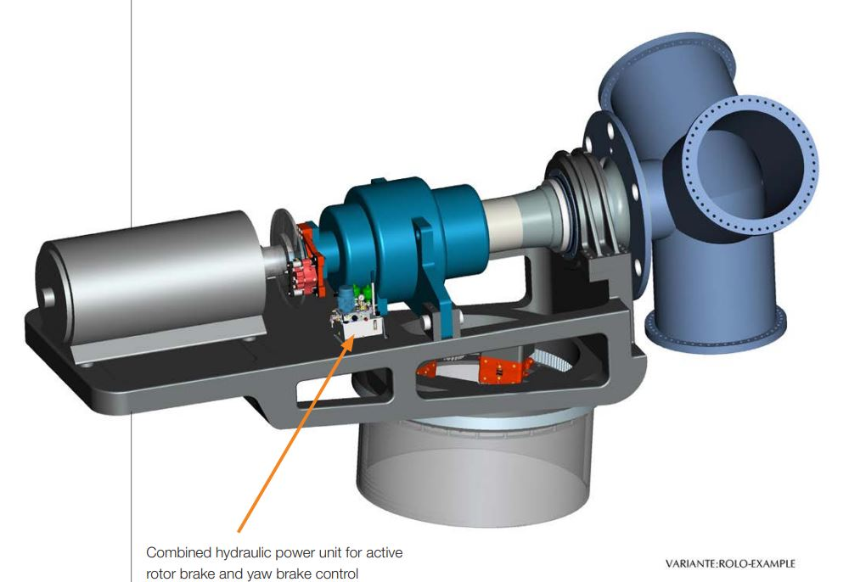
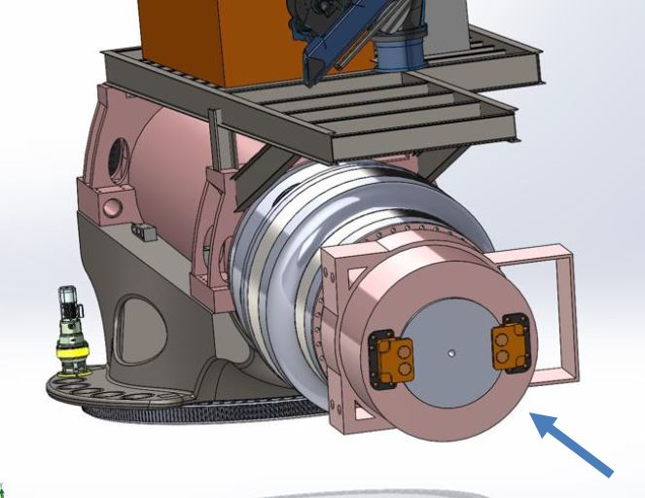
Rotor Brake
Main brake installation
Source: Optimus 200 XL Project
1 option
Installation on the HSS between gearbox and generator
Cons – mounting the generator on the frame, HSS coupling required
Source: https://www.svendborg-brakes.com/
2 option
Installation on the second generator shaft
possibility to mount the generator on the flange
14-10-2025
Nehang Jitendra Joshi
Gearbox, Brake, Coupling

Slide 10
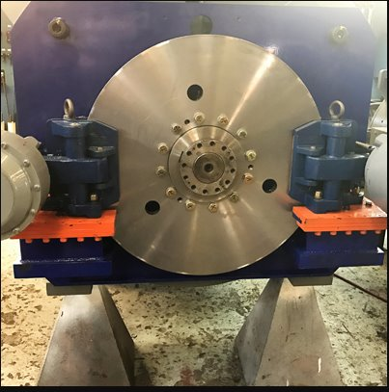
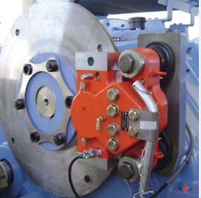
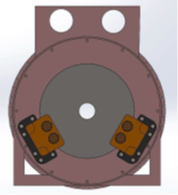
Rotor Brake
Number of break calliper
Two brake callipers
One brake calliper
Svendborg Model BSAK 3000 caliper brake
Source: Optimus 200XL
Source: SMI Corporation
14-10-2025
Nehang Jitendra Joshi
Gearbox, Brake, Coupling
10

Slide 11
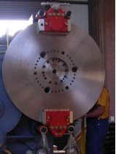
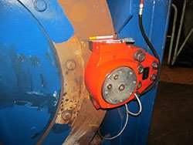
Rotor Brake
One brake calliper
Two brake callipers
Reaction force occurs
Possibility of torque
No balance
No generation of bearing reaction forces
Achieve balance
Source-Svendborg
Source-Svendborg
11
14-10-2025
Nehang Jitendra Joshi
Gearbox, Brake, Coupling

Slide 12
Coupling
Main Objective:
Layout design of coupling
Design criteria
LSS and HSS coupling
14-10-2025
Nehang Jitendra Joshi
Gearbox, Brake, Coupling

Slide 13
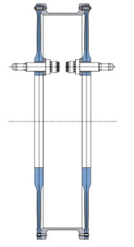
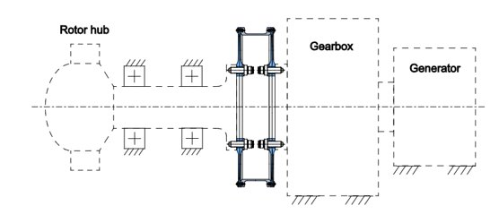
Coupling
Coupling Layout
Source: https://www.geislinger.com/en/products/product/compowind-coupling/
14-10-2025
Nehang Jitendra Joshi
Gearbox, Brake, Coupling

Slide 14
Coupling
Design Criteria
Torque transfer | Design criterion for a coupling is the torque and rotational speed it has to transfer during nominal operation | M_(N,lss) = (M_(N,gen) ∗i_gearbox)/η_gearboc
Permissible Elastic Vibratory Torque | nominal torque the coupling can transmit a vibratory torque | y="perm. elast vibratory torque" /"nominal torque" x="mean torque" /"nominal torque"
Torque overload protection | Limiting of torque after torque impulses due to electrical grid failures or generator short circuits | M_(breakdown ) = M_(N,lss)∗2.5
Permissible Misalignment | Axial Misalignment Radial Misalignment Angular Misalignment | From the calculations of tolerance
Loads deformation | Coupling housing has to sustain the loads of gearbox and generator which can results angular displacement | FEM and simulations with the finite element method (FEM)
14-10-2025
Nehang Jitendra Joshi
Gearbox, Brake, Coupling

Slide 15
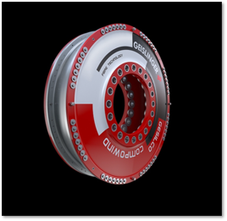
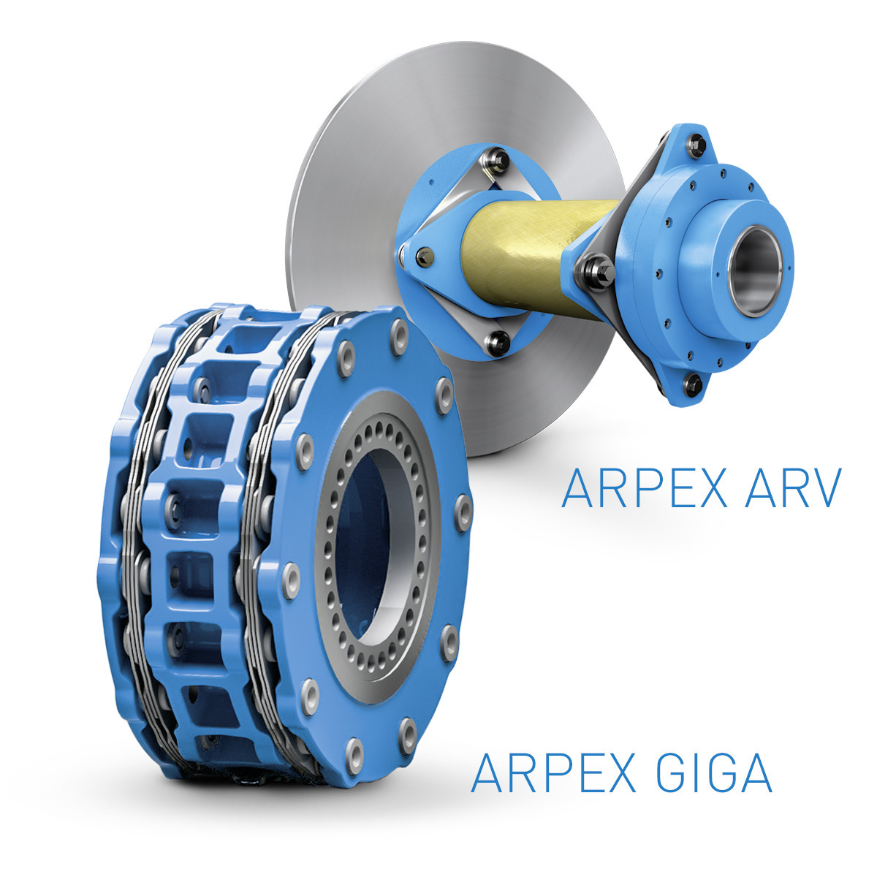
Coupling
LSS Coupling
HSS Coupling
Source-Flender arpex
Source: https://www.geislinger.com/en/products/product/compowind-coupling/
14-10-2025
Nehang Jitendra Joshi
Gearbox, Brake, Coupling

Slide 16
Bibliography
Gearbox
(1) Previous year Optimus projects
(2) IEC-61400-4
Brake
(1)Svendborg brake- https://svendborg-brakes.com/products/hydraulic-brakes/active-brakes/
Coupling
(1)Previous year project documents
(2)Geislinger and flender coupling
https://www.flender.com/en/cas/document/asm_coupling/ziuP--x-S4WQYPTrtKZFUQ/Datenblatt.pdf?refConfigId=ziuP--x-S4WQYPTrtKZFUQ&refMlfb=2LC0371-2BA99-0AF0
https://www.geislinger.com/cms_images/content/Coupling_18.0.pdf
14-10-2025
Nehang Jitendra Joshi
Gearbox, Brake, Coupling

